Slide 1
Memory Coherence in Shared Virtual Memory Systems
Yeong Ouk Kim, Hyun Gi Ahn

Slide 2
Contents
Introduction
Loosely coupled multiprocessor
Shared virtual memory
Memory coherence
Centralized manager algorithms
Distributed manager algorithms
Experiments
Conclusion

Slide 3
Virtual Memory
Each process having its own virtual memory (page table) having an illusion of it owning the whole memory (DRAM)
Rather than accessing the DRAM with the actual address, it manages a conceptual contiguous memory and MMU translates the virtual address to the physical address
MMU uses the page table to translate the virtual address (virtual page number) to the physical address (physical page number)
Page Table is not small and/so is kept in DRAM (kernel’s memory)
MMU uses TLB (a very fast but expensive Static RAM) to avoid using the page table every time (x2 DRAM accesses)

Slide 4
Virtual Memory (TLB, Page Table)

Slide 5
Virtual Memory (Context Switch)

Slide 6
Introduction
Designing a shared virtual memory for a loosely coupled multiprocessor that deals with the memory coherence problem
Loosely coupled multiprocessor
Shared virtual memory
Memory coherence

Slide 7
Loosely Coupled Multiprocessor
Processors (Machines) connected via messages (network) to form a cluster
This paper is not about distributed computing
The key goal is to allow processes (threads) from a program to execute on different processors in parallel
Slower (due to message delay and low data rate) but cheaper compared to tightly couples systems
Notes:
Mimic tightly connected multiprocessors
To achieve this we need to mimic the memory space

Slide 8
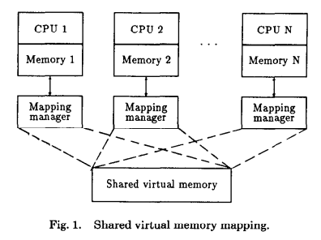
Shared Virtual Memory
Virtual address space shared among all processors
Read-only pages in multiple locations
Writable pages can only be in one place at a time
Page fault when the referenced page is not in the current processor’s physical memory
Notes:
Just like the traditional virtual memory the program itself treats it like actual physical memory
This might sound like a bad idea to some people since a page fault will require multiple messages between the processors

Slide 9
Locality
Frequently referencing the same data
Virtual Memory with sequential programs → High degree of locality
Parallel programs, while as a whole show low locality, each individual process is still a sequential program thus should show high locality
Notes:
But in reality its not that bad of an idea because locality is trait seen in the majority of programs

Slide 10
Message Passing vs Shared Memory

Slide 11
Memory Coherence
Memory is coherent if the value returned by a read operation is always the same as the most recent write operation to the same address
Architecture with one memory access is free from this problem but it is not sufficient for high performance demands
Loosely coupled multiprocessor → communication between processors is costly → less communication more work

Slide 12
Two Design Choices for SVM
Granularity
Strategy for maintaining coherence

Slide 13
Granularity
AKA page size
The size doesn’t really effect the communication cost
Small packet ≒ Large packet
However, larger page size can bring more contention on the same page → relatively small page size is preferred
Rule of thumb → choose a typical page size used in a conventional virtual memory → the paper suggests 1KB
Notes:
They only ran tests on 1kb and 32kb so there is not a good reason to believe 4kb will be worse than 1kb

Slide 14
Memory Coherence Strategies
Page synchronization
Invalidation
Write-broadcast
Page ownership
Fixed
Dynamic
Centralized
Distributed
Fixed
Dynamic
Notes:
-Page synchronization: How to sync up all processors on the event of page modification (write)
-

Slide 15
Page synchronization
Invalidation: one owner per page
Write-broadcast: writes to every copy when a write happens

Slide 16
Invalidation (page synchronization #1)
Write fault (processor Q and page p)
Invalidate all copies of p
Changes the access of p to write
Copy p to Q if Q doesn’t already have one
Return to the faulting instruction
Read fault
Changes the access of p to read on the processor that has write access to p
Move a copy of p to Q and set its access to read
Return to the faulting instruction
Notes:
-After write-fault processor Q owns page p → proceed write and other read/write operations until ownership is relinquished by another processor
-After read-fault processor Q can proceed with the read and other read operations until p is relinquished by someone else
Only one owner processor for each page

Slide 17
Write-broadcast (page synchronization #2)
Write-fault
Writes to all copies of the page
Return to the faulting instruction
Read-fault
Identical to invalidation
Notes:
-Every write to a shared page needs to generate a fault on the writing processor and update all copies → processor has the same page fault when returning to the faulting instruction
-Hardware must skip the faulted write cycle → No existing hardware with the functionality
-Snoopy cache approach → overhead of write fault to expensive
→ not practical for loosely coupled multiprocessors

Slide 18
Page ownership
Fixed
Dynamic
Centralized
Distributed
Fixed
Dynamic

Slide 19
Fixed Ownership
A page is always owned by the same processor
Other processors will never get full write access to the page
Negotiate with the owner → generate write-fault every time
Impossible for invalidation and expensive for write-broadcast
→ Not considered

Slide 20
Solutions to Memory Coherence Problem
Notes:
We only consider the algorithms that allows the owner to change
The three possible strategies are distinguished by how they manage the ownership data
Page fault handlers, servers, data structure

Slide 21
Data Structure (page table)
Access: indicates the accessibility to the page
i.e. Read or Write
Copy set: list of processors that own a read copy of the page
i.e. {1, 3}
Lock: Synchronizing multiple page faults by different processes on the same processor and synchronizing remote page requests
Notes:
Different algorithms have different data structures but they at least have these information about each page
Same page entry in different processors may be different
Broadcast or multicast invalidation do not require a copy set

Slide 22
Remote operations
Any remote operation will require two messages
Request and reply
Invalidation for m copies on an N processor system
 | Point-to-point | Broadcast | multicast
Requests | m | 1 | 1
Replies | m | m | m
 | Point-to-point | Broadcast | multicast
Send | 2m | m+1 | m+1
Receive | 2m | N+m-1 | 2m
N-1 in parallel
→ m+1 in best case
m in parallel
→ m+1 in best case
Notes:
Broadcast → N-1 messages are received in parallel
Multicast → m messages are received in parallel
1 <= Cost of receiving k messages in parallel <= k sequentially
Multicast has the best performance but most loosely coupled systems do not have a multicast facility (that can use the page table information)
On the other hand, broadcast invalidation is expensive when N is large

Slide 23
Centralized Manager
Centralized manager (monitor) resides on a single processor
Every page-fault needs to consult with this monitor
Manager
P1
Each Processor
P1
P2
P3
Info
Owner | Processor that owns the page
Copy set | Enables non-broadcast invalidation
Lock | Synchronize request to the page
PTable
Access
Lock | Synchronization within the processor

Slide 24
Demo (centralized manager)
Read page fault in P2
P1
Info
Owner | P3
Copy set | {P1}
Lock | 0
PTable
Access | R
Lock | 0
P2
P3
PTable
Access
Lock | 0
PTable
Access | R
Lock | 0

Slide 25
Demo (centralized manager)
Read page fault in P2
P1
Info
Owner | P3
Copy set | {P1}
Lock | 0
PTable
Access | R
Lock | 0
1. Request
P2
P3
PTable
Access
Lock | 1
PTable
Access | R
Lock | 0
Notes:
P2 locks itself to prevent any other faults from proceeding
Since it is not the manager ask the manager for read access to p and a copy of p

Slide 26
Demo (centralized manager)
Read page fault in P2
P1
Info
Owner | P3
Copy set | {P1, P2}
Lock | 1
PTable
Access | R
Lock | 0
1. Request
P2
P3
PTable
Access
Lock | 1
PTable
Access | R
Lock | 0
Notes:
Since P1 is not the manager PTable is untouched (lock immediately followed by unlock)
Since P1 is the manager add P2 to the copy set and lock so ~~~~

Slide 27
Demo (centralized manager)
Read page fault in P2
P1
Info
Owner | P3
Copy set | {P1, P2}
Lock | 1
PTable
Access | R
Lock | 0
1. Request
2. Ask to send copy to P2
P2
P3
PTable
Access
Lock | 1
PTable
Access | R
Lock | 0
Notes:
The manager asks the owner to send a copy to P2
Then it waits for a confirmation from P2

Slide 28
Demo (centralized manager)
Read page fault in P2
P1
Info
Owner | P3
Copy set | {P1, P2}
Lock | 1
PTable
Access | R
Lock | 0
1. Request
2. Ask to send copy to P2
P2
P3
PTable
Access
Lock | 1
PTable
Access | R
Lock | 1
3. Send Copy to P2
Notes:
Since P3 is the owner change access to Read and lock itself (access could have been W)
Then send copy to P2

Slide 29
Demo (centralized manager)
Read page fault in P2
P1
Info
Owner | P3
Copy set | {P1, P2}
Lock | 1
PTable
Access | R
Lock | 0
1. Request
2. Ask to send copy to P2
4. Confirmation
P2
P3
PTable
Access
Lock | 1
PTable
Access | R
Lock | 0
3. Send Copy to P2
Notes:
P3 is unlocked right after it sends the copy
When p2 receives the page from the owner it sends a confirmation to the manager

Slide 30
Demo (centralized manager)
Read page fault in P2
P1
Info
Owner | P3
Copy set | {P1, P2}
Lock | 0
PTable
Access | R
Lock | 0
1. Request
2. Ask to send copy to P2
4. Confirmation
P2
P3
PTable
Access | R
Lock | 0
PTable
Access | R
Lock | 0
3. Send Copy to P2
Notes:
Right after the confirmation is sent P2 gains Read access and is unlocked
The manager is unlocked when it receives the confirmation
→ Notice that the owner is not changed

Slide 31
Demo (centralized manager)
Write page fault in P2
P1
Info
Owner | P3
Copy set | {P1, P2}
Lock | 0
PTable
Access | R
Lock | 0
P2
P3
PTable
Access | R
Lock | 0
PTable
Access | R
Lock | 0

Slide 32
Demo (centralized manager)
Write page fault in P2
P1
Info
Owner | P3
Copy set | {P1, P2}
Lock | 0
PTable
Access | R
Lock | 0
1. Request
P2
P3
PTable
Access | R
Lock | 1
PTable
Access | R
Lock | 0
Notes:
Lock P2, since P2 is not the manager
Then ask the manager for write access to p

Slide 33
Demo (centralized manager)
Write page fault in P2
P1
Info
Owner | P3
Copy set | {P1, P2}
Lock | 1
PTable
Access
Lock | 0
1. Request
2. Invalidation
P2
P3
PTable
Access
Lock | 1
PTable
Access | R
Lock | 0
Notes:
Ptable is locked and immediately unlocked since it is not the owner of the page
Lock info table
Invalidate the read accesses using the copy set (if broadcast of multicast copy set is not needed)

Slide 34
Demo (centralized manager)
Write page fault in P2
P1
Info
Owner | P3
Copy set | {}
Lock | 1
PTable
Access
Lock | 0
1. Request
3. Ask to send page to P2
2. Invalidation
P2
P3
PTable
Access
Lock | 1
PTable
Access | R
Lock | 0
Notes:
Empty the copy set
And then tell the owner to send the page to P2

Slide 35
Demo (centralized manager)
Write page fault in P2
P1
Info
Owner | P3
Copy set | {}
Lock | 1
PTable
Access
Lock | 0
1. Request
3. Ask to send page to P2
2. Invalidation
P2
P3
PTable
Access
Lock | 1
PTable
Access
Lock | 1
4. Send Copy to P2
Notes:
Lock Ptable
Then send copy to P2
After sending the copy nullify the access permission of the table to the data

Slide 36
Demo (centralized manager)
Write page fault in P2
P1
Info
Owner | P3
Copy set | {}
Lock | 1
PTable
Access
Lock | 0
2. Invalidation
1. Request
3. Ask to send page to P2
5. Confirmation
P2
P3
PTable
Access
Lock | 1
PTable
Access
Lock | 0
4. Send Copy to P2
Notes:
P3 unlocks itself to finalize its task
Meanwhile P2 receives the copy and sends a confirmation to the manager

Slide 37
Demo (centralized manager)
Write page fault in P2
P1
Info
Owner | P2
Copy set | {}
Lock | 0
PTable
Access
Lock | 0
2. Invalidation
1. Request
3. Ask to send page to P2
5. Confirmation
P2
P3
PTable
Access | W
Lock | 0
PTable
Access
Lock | 0
4. Send Copy to P2
Notes:
Manger will receive the confirmation and unlock the info table
!!!!!!!!!!!!! THIS could be wrong
The manager can potentially update the owner at this point but it could have also done so right after it asked P3 to send the page
The code in the paper seems to have a typo and is missing this part
After P2 sending the confirmation it will gain write access and unlock itself

Slide 38
Overview (centralized manager)
Locking is handled separately (local, remote)
Traffic bottleneck at the at the manager
Worse as N gets bigger
Worst-case number of messages to locate a page is two (manager → owner)
This is considerably low but the confirmation message is required every time there is a fault
→ Eliminate confirmation messages for improvement
Notes:
Number of messages for locating a page is a measure of the complexity of the algorithm
All done and said it is still an ok performance according to the test above

Slide 39
Improved Centralized Manager
Synchronization of page ownership has been moved to the individual owners → eliminating the confirmation operation to the manager
Lock in each processor now also deals with synchronizing remote requests (while still dealing with multiple local requests)
Manager still answers where the page owner is

Slide 40
Improved Centralized Manager
Modify the data structure to accommodate
Copy set is only valid iff the processor is the owner of the page
Manager
P1
Each Processor
P1
P2
P3
Owner
Owner | Processor that owns the page
PTable
Access
Lock | Now deals with local and remote requests
Copy set | Enables non-broadcast invalidation

Slide 41
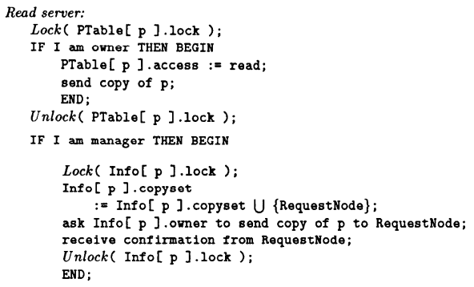
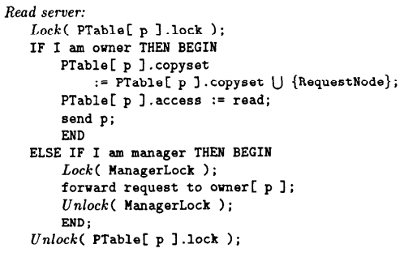
Improved Centralized Manager

Slide 42
Improved Centralized Manager
Compared to previous implementation
Improves performance by decentralizing the synchronization
Read page faults → for all processors saves one send and one receive
But on large N → bottleneck still exists since the manager must respond to every page fault
→ We must distribute the ownership management duty
Notes:
Hyun gi will talk about the distributed algorithms

Slide 43
A Fixed Distributed Manager Algorithm
Each processor is given a predetermined subset of pages to manage
Mapping pages to appropriate processors is a difficult task and uses a hash function
Page fault handling applies the hash function to get the manager for the page and follows the same procedure as centralized manager
It is difficult to find a good fixed distribution function that fits all application well

Slide 44
A Broadcast Distributed Manager Algorithm (1)
Read page fault
P1
Requestor
P2
Owner
(1) requestor: lock PTable[page#]
(2) requestor: broadcast read access request
(3) owner: lock PTable[page#]
(4) owner: add requestor to PTable[page#].copy-set
(5) owner: PTable[page#].access = read
(6) owner: send the copy to requestor
(7) owner: unlock PTable[page#]
(6) requestor: receive the page from the owner
(7) requestor: PTable[page#].access = read
(8) requestor: unlock PTable[page#]

Slide 45
A Broadcast Distributed Manager Algorithm (2)
Write page fault
P1
Requestor
P2
Owner
(1) requestor: lock PTable[page#]
(2) requestor: broadcast write access request
(3) owner: lock PTable[page#]
(4) owner: send the page and copy-set to requestor
(5) owner: PTable[page#].access = null
(6) owner: unlock PTable[page#]
(4) requestor: receive the page & copy-set from the owner
(5) requestor: invalidate(page, PTable[page#].copy-set)
(6) requestor: PTable[page#].access = write
(7) requestor: PTable[page#].copy-set = empty
(8) requestor: PTable[page#].owner = myself
(9) requestor: unlock PTable[page#]

Slide 46
A Dynamic Distributed Manager Algorithm (1)
Read page fault
(1) requestor: lock PTable[page#]
(2) requestor: send read access request to PTable[page#].probOwner
(3) probOwner: lock PTable[page#]
(4) probOwner: forward the request to PTable[page#].probOwner, if I am not the real owner
(5) probOwner: unlock PTable[page#]
(5) owner: lock PTable[page#]
(6) owner: add requestor to PTable[page#].copy-set
(7) owner: PTable[page#].access = read
(8) owner: send the page to the requestor
(9) owner: unlock PTable[page#]
(8) requestor: receive the page from the owner
(9) requestor: PTable[page#].probOwner = owner
(10) requestor: PTable[page#].access = read
(11) requestor: unlock PTable[page#]

Slide 47
A Dynamic Distributed Manager Algorithm (2)
Write page fault
(1) requestor: lock PTable[page#]
(2) requestor: send write access request to PTable[page#].probOwner
(3) probOwner: lock PTable[page#]
(4) probOwner: forward the request to PTable[page#].probOwner, if not the real owner
(5) probOwner: PTable[page#].probOwner = requestor
(6) probOwner: unlock PTable[page#]
(5) owner: lock PTable[page#]
(6) owner: PTable[page#].access = null
(7) owner: send the page and copy-set to the requestor
(8) owner: PTable[page#].probOwner = requestor
(9) owner: unlock PTable[page#]
(7) requestor: receive the page & copy-set from the owner
(8) requestor: invalidate(page, PTable[page#].copy-set)
(9) requestor: PTable[page#].access = write
(10) requestor: PTable[page#].copy-set = empty
(11) requestor: PTable[page#].probOwner = myself
(12) requestor: unlock PTable[page#]
(8) copy holders: receive invalidate
(9) copy holders: lock PTable[page#]
(10) copy holders: PTable[page#].access = null
(11) copy holders: PTable[page#].probOwner = requestor
(12) copy holders: unlock PTable[page#]

Slide 48
An Improvement by Using Fewer Broadcasts
By periodically broadcasting the real owner, the number of steps to find the owner can be reduced

Slide 49
Distribution of Copy Sets (1)
So far only the copy-set of the owner is correct and complete. This requires that:
the page should be copied from the owner to maintain the copy-set correct
invalidation should be broadcasted from the owner to every copy-holders
Key Ideas
copy the page from any of copy holder
maintain copy-holders in a tree (with the owner as the root) and propagate invalidation from the owner

Slide 50
Distribution of Copy Sets (2)
Read page fault
(1) requestor: lock PTable[page#]
(2) requestor: send read access request to PTable[page#].probOwner
(3) probOwner: lock PTable[page#]
(4) probOwner: forward the request to PTable[page#].probOwner, if it does not have the copy
(5) probOwner: unlock PTable[page#]
(5) copy-holder: lock PTable[page#]
(6) copy-holder: add requestor to PTable[page#].copy-set
(7) copy-holder: PTable[page#].access = read
(8) copy-hoder: send the page to the requestor
(9) owner: unlock PTable[page#]
(8) requestor: receive the page from the owner
(9) requestor: PTable[page#].probOwner = copy-holder
(10) requestor: PTable[page#].access = read
(11) requestor: unlock PTable[page#]

Slide 51
Distribution of Copy Sets (3)
Write page fault
(1) requestor: lock PTable[page#]
(2) requestor: send write access request to PTable[page#].probOwner
(3) probOwner: lock PTable[page#]
(4) probOwner: forward the request to PTable[page#].probOwner, if not the owner
(5) probOwner: PTable[page#].probOwner = requestor
(6) probOwner: unlock PTable[page#]
(5) owner: lock PTable[page#]
(6) owner: PTable[page#].access = null
(7) owner: send the page and copy-set to the requestor
(8) owner: PTable[page#].probOwner = requestor
(9) owner: unlock PTable[page#]
(7) requestor: receive the page & copy-set from the owner
(8) requestor: invalidate(page, PTable[page#].copy-set)
(9) requestor: PTable[page#].access = write
(10) requestor: PTable[page#].copy-set = empty
(11) requestor: PTable[page#].probOwner = myself
(12) requestor: unlock PTable[page#]
(8) copy holders: receive invalidate
(9) copy holders: lock PTable[page#]
(10) copy holders: propagate invalidation to its copy-set
(11) copy holders: PTable[page#].access = null
(12) copy holders: PTable[page#].probOwner = requestor
(13) copy holders: PTable[page#].copy-set = empty
(14) copy holders: unlock PTable[page#]

Slide 52
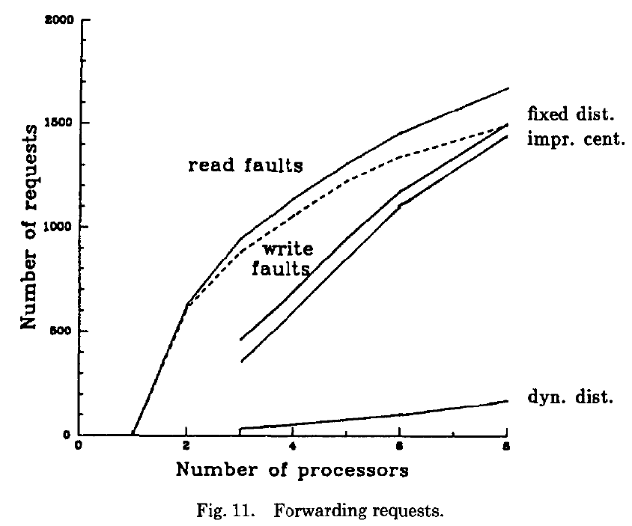
Experiments
Compare to memory coherence algorithms
All algorithms have similar number of page faults. Due to the limitation on the number of processors
The number of forwarding requests was used as a criterion for comparing algorithms. (Overhead = Messages = Requests )
both algorithms need a forwarding request to locate the owner of the page for almost every page fault that occurs on a nonmanager processor.
ProbOwner fields usually give correct hints
Notes:
The curve of the forwarding requests of the fixed distributed manager algorithm is similar to that of the improved centralized manager algorithm
The figures show that the overhead of the dynamic distributed manager algorithm is much less than that of the other two algorithms.

Slide 53
Conclusion
This paper studied two general classes of algorithms for solving the memory coherence problem
Centralized manager
Straightforward and easy to implement
Traffic bottleneck at the central manager
Distributed Manager
Fixed dist. Manager
Alleviates the bottleneck
On average, still need to spend about two message to locate an owner
Dynamic dist. Manager
The most desirable overall features
This paper gives possibility of using a shared virtual memory system to construct a large-scale shared memory multiprocessor system

